Slide 1
Basic Data Analysis
Emanuele Della Valle
Prof. @ Politecnico di Milano
Founder & Partner @ Quantia Consulting
Marco Balduini
Founder & CEO @ Quantia Consulting

Slide 2
Introduction

Slide 3
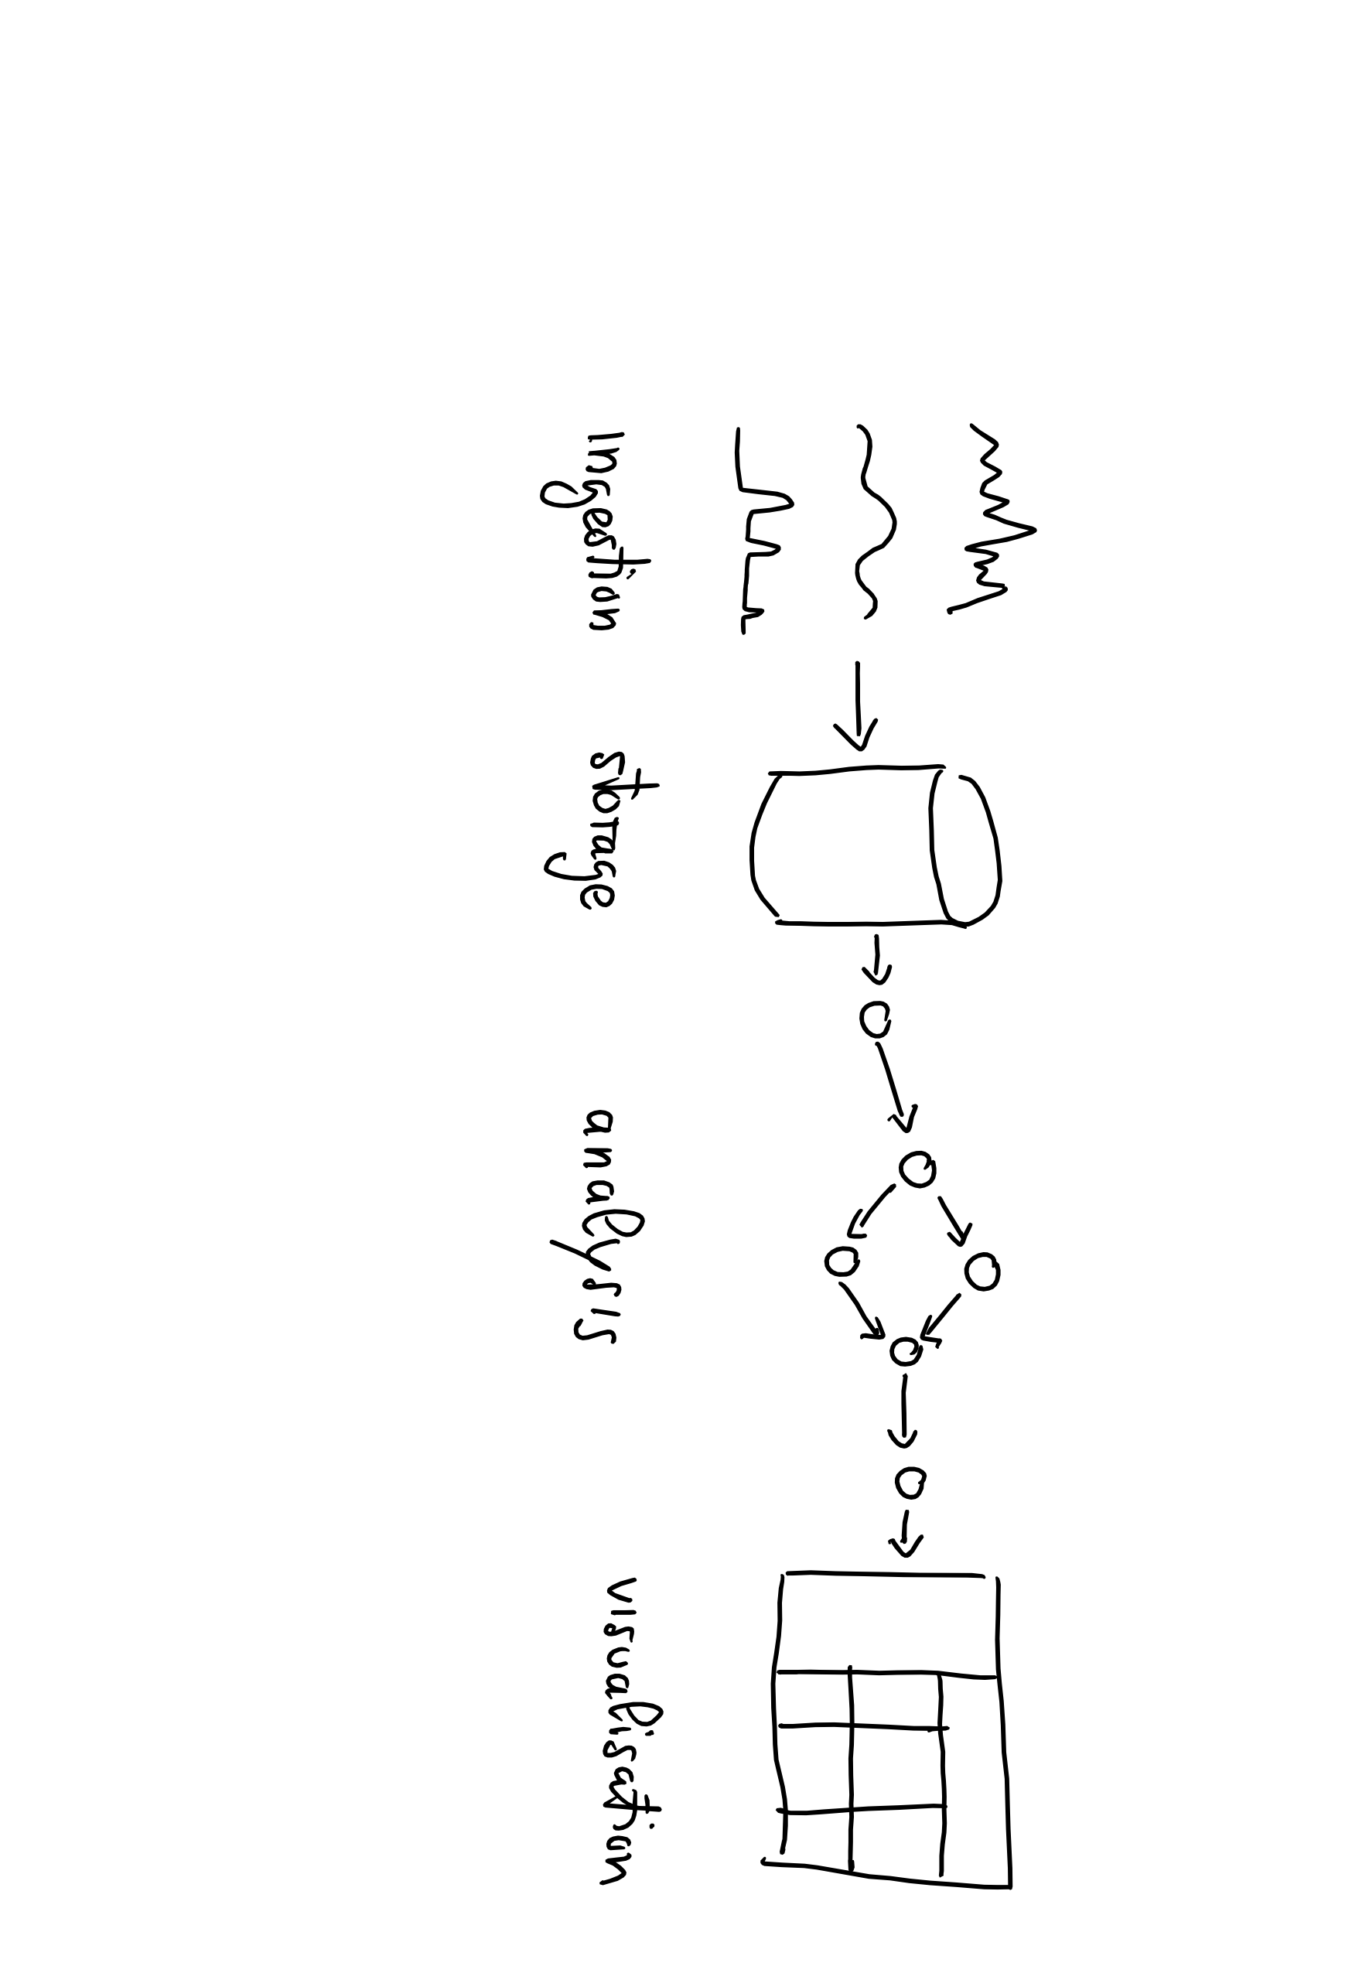
Data Lifecycle

Slide 4

Data Lifecycle

Slide 6
Why Flux?
I don't want to have to write query code in one language and processing code in another language.
– Paul Dix - CTO InfluxData

Slide 7
What Is Flux?
Flux Query Language?
Flux Query Language?
Query + Process + Act
Flux Data Scripting Language

Slide 8
What Is Flux?
Written to be:
Useable: easy to learn
Readable: developers read more code than we write
Extensible: developers can extend the language
Composable: developers can build onto the language
Testable: queries are code
Contributable: open source contributions matter

Slide 9
What is Flux? (cont.)
Open Source (MIT)
Data-first mentality
Streaming Data
Planner-optimized
Compatible with multiple sources and sinks

Slide 10
Flux vs. InfluxQL
Flux is an alternative to InfluxQL with additional functionality like:
Joins
Math across measurements
Sort by any column
Pivot
Histograms
Covariance
Reference: https://v2.docs.influxdata.com/v2.0/query-data/

Slide 11
Exploring flux Basics

Slide 12
Basic Flux Language Elements
Anatomy of a Flux script:
data source
time range
data filters
Anonymous function
from(bucket:"telegraf/autogen")
|> range(start:-1h)
|> filter(fn: (r) =>
r._measurement == "cpu" and
r._field == "system" and
r._value > 2000.0)
Pipe-forward operator: chain operations together

Slide 13
Basic Flux Language Elements
Anatomy of a Flux script:
data source
time range
data filters
parameter(s)
from(bucket:"telegraf/autogen")
|> range(start:-1h)
|> filter(fn: (r) =>
r._measurement == "cpu" and
r._field == "system" and
r._value > 2000.0)
expression(s)

Slide 14
Flux Data Model
:o
An infinite stream…
of finite tables…
identified by the GroupKey

Slide 15
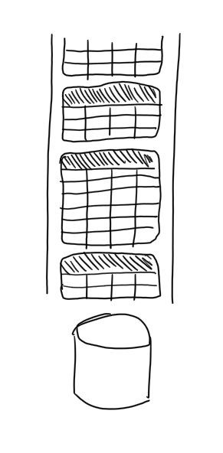
Flux Data Model
An infinite stream…
of finite tables…
identified by the GroupKey

Slide 16
From bucket to tables
_time | _m | host | _field | _value
14…0 | cpu | serverA | system | 2342
14…2 | cpu | serverA | system | 477
GroupKey[cpu, serverA, system]
_time | _m | host | _field | _value
14…1 | cpu | serverB | system | 2779
14…3 | cpu | serverB | system | 1274
GroupKey[cpu, serverB, system]
_time | _m | host | _field | _value
14…1 | cpu | serverB | idle | 1789
14…2 | cpu | serverB | idle | 2475
GroupKey[cpu, serverB, idle]
[…]
from(bucket:"telegraf/autogen")
|> range(start:-1s)
_time
_m
host
idle
system
14…0
cpu
serverA
1667
2342
…
…
…
…
…
14…1
cpu
serverB
1789
2779
_m = _measurement

Slide 17
Query Process
:o
For Each Table:
Convert incoming rows into 0 or more outgoing rows
Map outgoing rows to tables

Slide 18
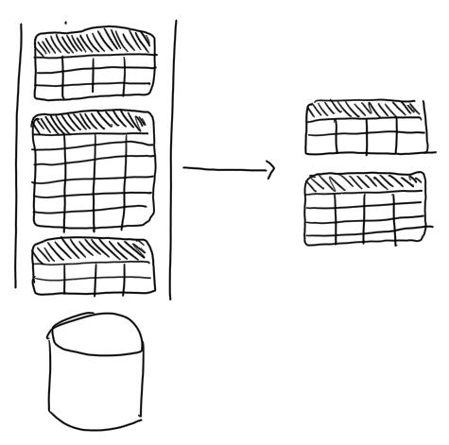
Query Process
For Each Table:
Convert incoming rows into 0 or more outgoing rows
Map outgoing rows to tables

Slide 19
_time | _m | host | _field | _value
14…1 | cpu | serverB | idle | 1789
14…2 | cpu | serverB | idle | 2475
GroupKey[cpu, serverB, idle]
∅
|> filter(fn: (r) =>
r._measurement == "cpu" and
r._field == "system" and
r._value > 2000.0)
_time | _m | host | _field | _value
14…1 | cpu | serverB | system | 2779
14…3 | cpu | serverB | system | 1274
GroupKey[cpu, serverB, system]
_time | _m | host | _field | _value
14…1 | cpu | serverB | system | 2779
GroupKey[cpu, serverB, system]
[…]
[…]
_time | _m | host | _field | _value
14…0 | cpu | serverA | system | 2342
14…2 | cpu | serverA | system | 477
GroupKey[cpu, serverA, system]
_time | _m | host | _field | _value
14…0 | cpu | serverA | system | 2342
GroupKey[cpu, serverA, system]

Slide 20
The Life of a Flux Query
Client
Server
query text
Parser
AST
Evaluator
Query Op-Spec
Procedure Spec
Planner/ Optimizer
Transformation Spec
:)

Slide 21
Quiz
What’s a Bucket?
What’s the Pipe-forward operator |> for?
What’s a Table in Flux?
What’s a Group Key in Flux?
List of columns for which every row in a table has the same value
A named data source with retention policy
Chains operations
A part of a result

Slide 22
Quiz answer
What’s a Bucket?
What’s the Pipe-forward operator |> for?
What’s a Table in Flux?
What’s a Group Key in Flux?
[1:B, 2:C, 3:D, 4:A]
List of columns for which every row in a table has the same value
A named data source with retention policy
Chains operations
A part of a result

Slide 23
Exploring flux Windowing

Slide 24

Key concepts
window
Data Sources
Registered Continuous Query
streams of answer
input streams
E. Della Valle

Slide 25
Windows
Streams are infinite in nature
Processing can end only if the input is finite
A window operator selects a finite portion of a stream
Time range is a window operator whose input is a time interval specified either stating an absolute start and end time
range(start: 2019-10-01T00:00:00Z, stop: 2019-10-01T00:05:00Z)
or stating a relative time period relative
range(start:-2h, stop: -1h)
range(start:-1h)

Slide 26

Let’s get dirty!
2

Slide 27
Continuous Linear Pizza Oven
Learning goals:
Data source
Window
Tables
s2
s1

Slide 28
Task
Extract all the measurements in a given range
Absolute: from 2020-04-30T10:00:00Z to 2020-04-30T10:05:00Z
Relative: in the last 24 hours
Take home message
The range() function extracts from the named bucket all the possible tables in the given time range

Slide 29
Let’s get dirty!
3

Slide 30
Continuous Linear Pizza Oven
Learning goals:
Filter by tag
s2
s1

Slide 31
Task
Extract the temperature data from the cooking base area (sensor S1)
Take home message
The filter() function applied to tags selects only the table(s) of your interest from all the possible tables

Slide 32
Let’s get dirty!
4

Slide 33
Continuous Linear Pizza Oven
Learning goals:
Filter by value
s2
s1

Slide 34
Task
Extract the measurements from the cooking base area (sensor S1) with a temperature under 300°
Take home message
The filter() function applied to values selects only the row(s) of your interest from all the possible tables

Slide 35
Exploring flux Shaping and Processing

Slide 36
All Flux Language Elements
Anatomy of a Flux script:
data source
time range
data filters
shaping
processing
from(bucket:"telegraf/autogen")
|> range(start:-1h)
|> filter(fn: (r) =>
r._measurement == "cpu" and
r._field == "system" and
r._value > 2000.0)
|> group(columns: ["_field"])
|> mean()

Slide 37
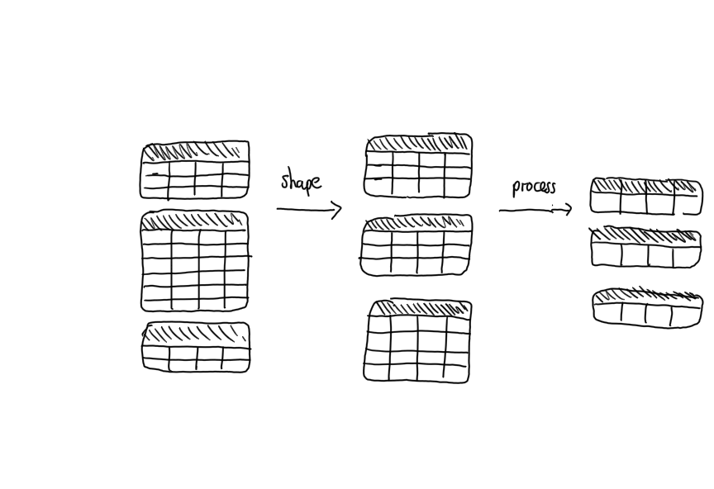

Slide 38
Exploring flux Shaping with group Processing with aggregators and selectors

Slide 39
_time | _m | host | _field | _value
10:45 | cpu | serverA | system | 1000
11:45 | cpu | serverA | system | 3000
GroupKey[cpu, serverA, system]
_time | _m | host | _field | _value
11:00 | cpu | serverB | system | 2000
11:30 | cpu | serverB | system | 2000
GroupKey[cpu, serverB, system]
_time | _m | host | _field | _value
10:45 | cpu | serverA | system | 1000
11:00 | cpu | serverB | system | 2000
11:30 | cpu | serverB | system | 2000
11:45 | cpu | serverA | system | 3000
GroupKey[system]
group(columns: [”_field"])
_time | _m | host | _field | _value
10:35 | cpu | serverA | idle | 100
GroupKey[cpu, serverA, idle]
_time | _m | host | _field | _value
10:35 | cpu | serverA | idle | 100
11:15 | cpu | serverB | idle | 200
11:50 | cpu | serverB | idle | 400
GroupKey[idle]
_time | _m | host | _field | _value
11:15 | cpu | serverB | idle | 200
11:50 | cpu | serverB | idle | 400
GroupKey[cpu, serverB, idle]

Slide 40
Example of aggregator
_time | _m | host | _field | _value
10:45 | cpu | serverA | system | 1000
11:00 | cpu | serverB | system | 2000
11:30 | cpu | serverB | system | 2000
11:45 | cpu | serverA | system | 3000
GroupKey[system]
_field | _value
system | 2000
GroupKey[system]
|> mean()
_time | _m | host | _field | _value
10:35 | cpu | serverA | idle | 100
11:15 | cpu | serverB | idle | 200
11:50 | cpu | serverB | idle | 400
GroupKey[idle]
_field | _value
idle | 233,33
GroupKey[idle]
NOTE: time, measurement, and host columns get deleted

Slide 41
Example of selector
_time | _m | host | _field | _value
10:45 | cpu | serverA | system | 1000
11:00 | cpu | serverB | system | 2000
11:30 | cpu | serverB | system | 2000
11:45 | cpu | serverA | system | 3000
GroupKey[system]
_time | _m | host | _field | _value
11:45 | cpu | serverA | system | 3000
GroupKey[system]
|> last()
_time | _m | host | _field | _value
10:35 | cpu | serverA | idle | 100
11:15 | cpu | serverB | idle | 200
11:50 | cpu | serverB | idle | 400
GroupKey[idle]
_time | _m | host | _field | _value
11:50 | cpu | serverB | idle | 400
GroupKey[idle]

Slide 42
Let’s get dirty!
5

Slide 43
Continuous Linear Pizza Oven
Learning goals:
Function
group()
Aggregates
Selectors
s2
s1

Slide 44
Task
Grouping + Aggregator - Extract the average temperature and the average humidity along the different stages (S1 and S2) of the linear pizza oven
Selector - Extract the last temperature and humidity observations from the cooking base area
Take home message
Grouping shapes tables
Aggregators (e.g. mean) compress each table in a row
Selectors (e.g. last) select specific row(s) from each table
Notes:
from(bucket: "training")
|> range(start: v.timeRangeStart, stop: v.timeRangeStop)
|> filter(fn: (r) => r._measurement == "iot-oven")
|> group(columns: ["_field"])
|> mean()

Slide 45
Exploring flux Advanced Windowing

Slide 46
Recall
window
Data Sources
Registered Continuous Query
streams of answer
input streams
E. Della Valle

Slide 47
Windows
Streams are infinite in nature
Processing can end only if the input is finite
A window operator selects a finite portion of a stream
We have seen the time range operator
Flux includes a window operator that builds table tumbling across the results of the time range operator
e.g. aggregateWindow(every: 60m, fn: mean)

Slide 48
Example of tumbling window
Anatomy of a Flux query:
data source
time range
data filters
shaping
processing
from(bucket:"telegraf/autogen")
|> range(start:-1h)
|> filter(fn: (r) =>
r._measurement == "cpu" and
r._field == "system" and
r._value > 2000.0)
|> aggregateWindow(every: 60m, fn: mean)

Slide 49

Tumbling?

Slide 50
Tumbling windows
E. Della Valle
[1]

Slide 51
Tumbling windows
E. Della Valle
[1] [2]

Slide 52
Tumbling windows
E. Della Valle
[1] [2] [3]

Slide 53
Tumbling windows
E. Della Valle
[1] [2] [3] [4]

Slide 54
Tumbling windows
E. Della Valle
[1] [2] [3] [4] [5]

Slide 55
Tumbling windows
E. Della Valle
[1] [2] [3] [4] [5] [6]

Slide 56
Tumbling windows
E. Della Valle
[1] [2] [3] [4] [5] [6] [7]

Slide 57
NOTE: host column gets deleted
_time | _m | host | _field | _value
10:45 | cpu | serverA | system | 1000
11:00 | cpu | serverB | system | 2000
11:30 | cpu | serverB | system | 2000
11:45 | cpu | serverA | system | 3000
GroupKey[system]
_time | _m | _field | _value
11:00 | cpu | system | 1000
GroupKey[system]
|> aggregateWindow( every: 60m, fn: mean)
_time | _m | _field | _value
11:00 | cpu | idle | 100
GroupKey[idle]
_time | _m | host | _field | _value
10:35 | cpu | serverA | idle | 100
11:15 | cpu | serverB | idle | 200
11:50 | cpu | serverB | idle | 400
GroupKey[idle]
NOTE: The start time is not included, the stop time is

Slide 58
NOTE: host column gets deleted
_time | _m | _field | _value
11:00 | cpu | system | 1000
GroupKey[system]
_time | _m | host | _field | _value
10:45 | cpu | serverA | system | 1000
11:00 | cpu | serverB | system | 2000
11:30 | cpu | serverB | system | 2000
11:45 | cpu | serverA | system | 3000
GroupKey[system]
_time | _m | _field | _value
11:00 | cpu | system | 1000
12:00 | cpu | system | 2333.3
GroupKey[system]
|> aggregateWindow( every: 60m, fn: mean)
_time | _m | _field | _value
11:00 | cpu | idle | 100
GroupKey[idle]
_time | _m | _field | _value
11:00 | cpu | idle | 100
12:00 | cpu | idle | 300
GroupKey[idle]
_time | _m | host | _field | _value
10:35 | cpu | serverA | idle | 100
11:15 | cpu | serverB | idle | 200
11:50 | cpu | serverB | idle | 400
GroupKey[idle]
NOTE: The start time is not included, the stop time is

Slide 59
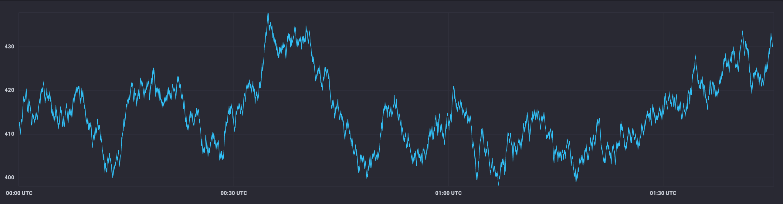
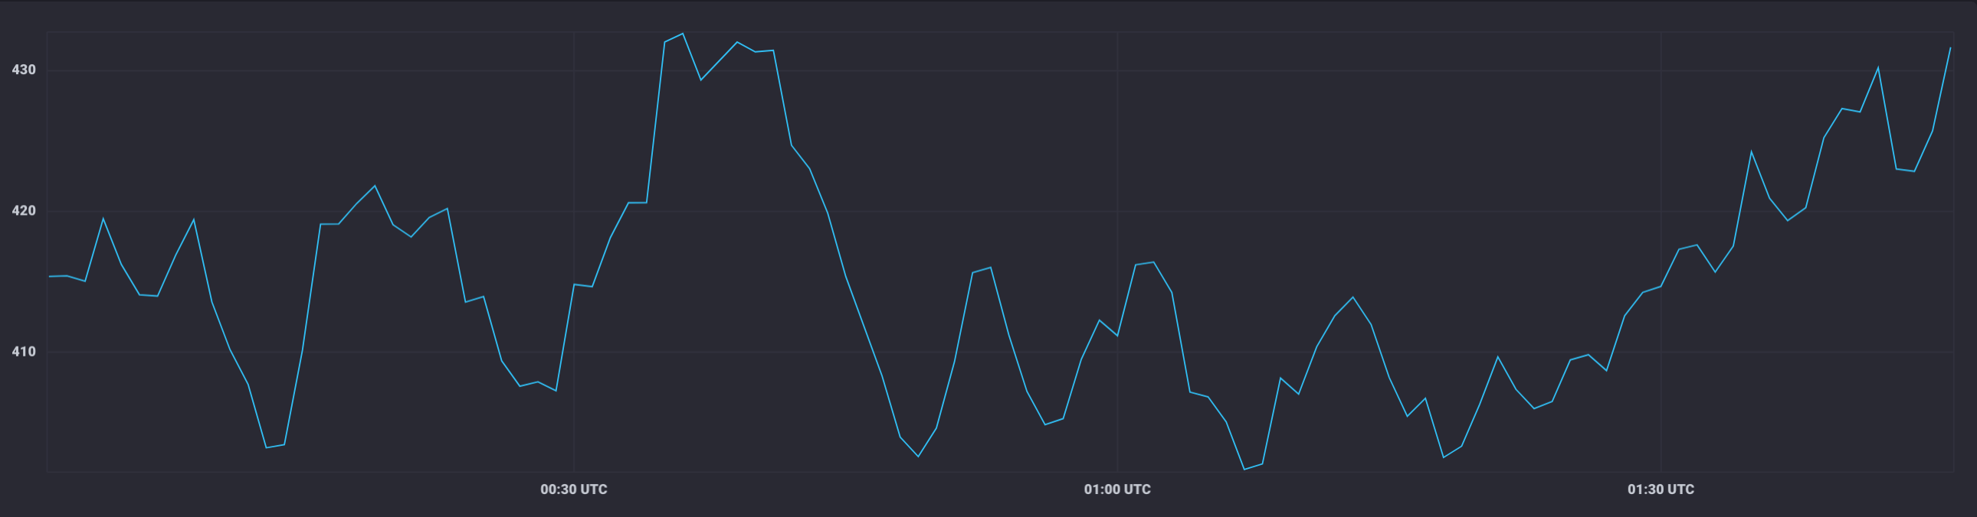
Typical use case: downsampling data
aggregateWindow(every: 1m, fn: mean)

Slide 60
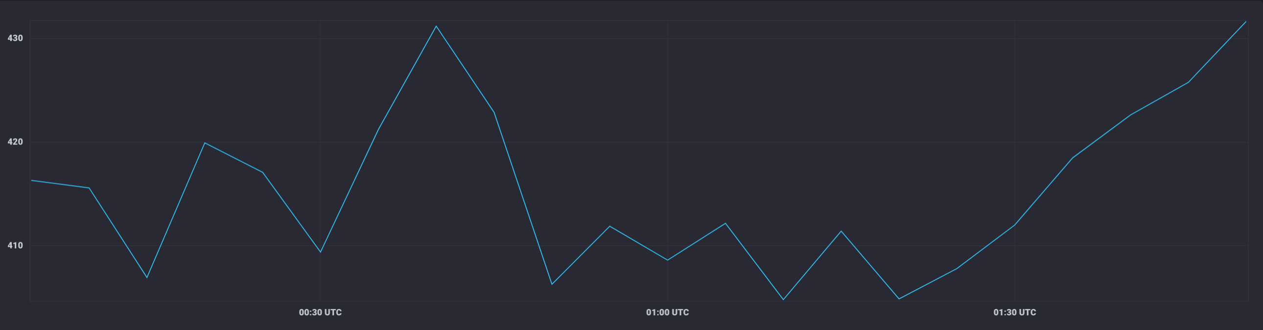
Typical use case: downsampling data (cont.)
aggregateWindow(every: 5m, fn: mean)

Slide 61
Let’s get dirty!
6

Slide 62
Continuous Linear Pizza Oven
Learning goals:
aggregateWindow
s2
s1

Slide 63
Task
Extract the moving average of the temperatures observed in the cooking base area over a window of 2 minutes
Extract the moving average of the temperatures observed by S2 over a window of 3 minutes

Slide 64
Quiz
True or false
you can omit the range clause – ?
filtering can change the number of tables in the result – ?
shaping always changes the number of tables in the result – ?
processing can change the number of tables in the result – ?
aggregateWindow function is just a process step – ?
aggregateWindow function eases the downsampling task – ?
the parameter createEmpty of the aggregateWindow function can change the number of tables in the result – ?

Slide 65
Quiz answer
True or false
you can omit the range clause – F
filtering can change the number of tables in the result – T (empty tables)
shaping always changes the number of tables in the result – F
processing can change the number of tables in the result – F
aggregateWindow function is just a process step – F
aggregateWindow function eases the downsampling task – T
the parameter createEmpty of the aggregateWindow function can change the number of tables in the result – T

Slide 66
Basic Data Analysis
Emanuele Della Valle Prof. @ Politecnico di Milano & Partner @ Quantia Consulting
Marco Balduini Founder & CEO @ Quantia Consulting

